Slide 1
Chapter 6
Lists and Strings

Slide 2
Contents Points
List Definition
Implementation of Lists
  Class Templates
  Contiguous Implementation
  Simply Linked Implementation
  Doubly Linked Lists
  Comparison of Implementations
Strings

Slide 3

List Definition
A list of elements of type T is a finite sequence of elements of T together with the following operations:
    Construct the list, leaving it empty
    Determine whether the list is empty or not
    Determine whether the list is full or not
    Find the size of the list
    Clear the list to make it empty
    Insert an entry at a specified position of the list
    Remove an entry from a specified position in the list.
    Retrieve an entry from a specified position in the list.
    Replace the entry at a specified position in the list.
    Traverse the list, performing a given operation on each entry.

Slide 4
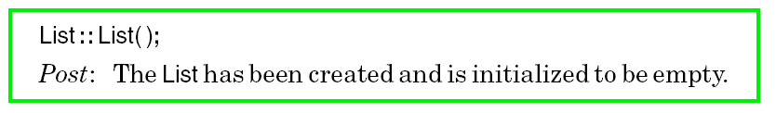

List Definition
Some Important Concepts
  ADT (Abstract Data Type)
  STL (Standard Template Library)
  STL classes list and vector
Method Specifications

Slide 5
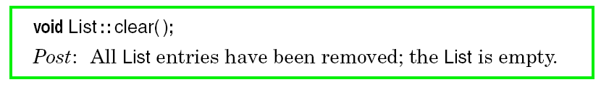
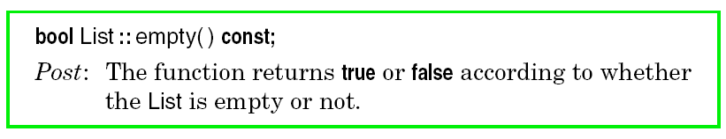
List Definition
Method Specifications

Slide 6
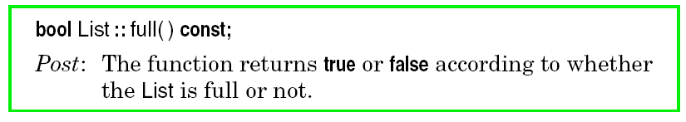
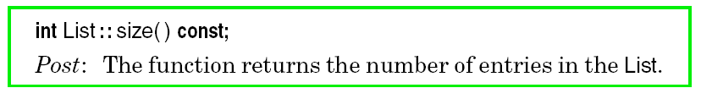

List Definition
Method Specifications

Slide 7
1、关于position（位序）的含义
将长度为n(n>0)的非空表记为如下形式：
L=(a₀,a₁,a₂,…a_{i}…a_{n-1}），其中a_{o}的position是0，a_{i}的position是i。
2、根据position进行元素的插入、删除、读写等操作。

Slide 8
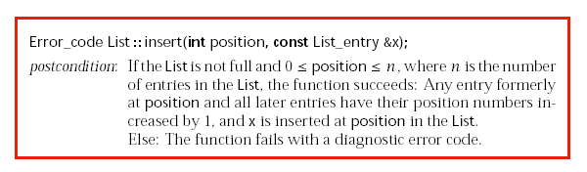
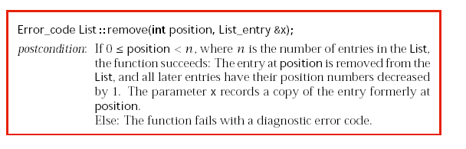

Slide 9
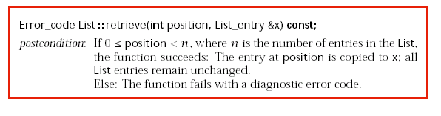
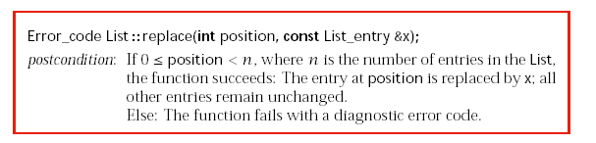

Slide 10
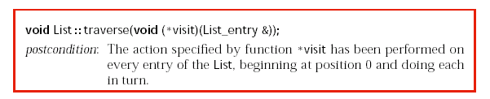

Slide 11
Class Template
Define format
    template <class Entry_type_param>
    class List{
    //Add in member information for the class
    };
Usage way
    List <real_type> list_obj;
    example:
    List <int> first_list;
    List<char> second_list;

Slide 12
Contiguous Implementation
template definition
    template <class List_entry>
    class List{
    List(); //构造函数
    int size() const;
    bool full() const;
    bool empty() const;
    void clear();
    void traverse(void (*visit)(List_entry& ));
    Error_code retrive(int position,List_entry& x) const;
    Error_code replace(int position, const List_entry& x);
    Error_code remove(int position, List_entry& x);
    Error_code insert(int position, const List_entry& x);
    private: //私有成员数据
    int count;
    List_entry entry[max_list]; //所谓contiguous是指采用数组方式存储
    };

Slide 13
Contiguous Implementation
Realization of some member functions
    template <class List_entry>
    int List <List_entry>::size() const{
    return count;
    }

Slide 14
    template <class List_entry>
    Error_code List<List_entry>::insert(int position, const List_entry& x)
    {
    }

Slide 15
    template <class List_entry>
    Error_code List<List_entry>::insert(int position, const List_entry& x)
    {
    if (full()) return overflow; //溢出
    if (position<0||position>count)
    return range_over; //插入点错误
    for (int i=count-1;i>=position; i--)
    entry[i+1]=entry[i]; //移动元素（从后向前）
    entry[position]=x; //放入元素
    count++; //增加统计个数
    return success;
    }//加上图示

Slide 16
L.Insert (4, 66)
i
position
i
i
i
21 18 30 75 42 56 87
0
count-1
21 18 30 75
66
42
56
87
    for (int i=count-1;i>=position; i--)
    entry[i+1]=entry[i]; //移动元素（从后向前）entry[position]=x; //放入元素

Slide 17
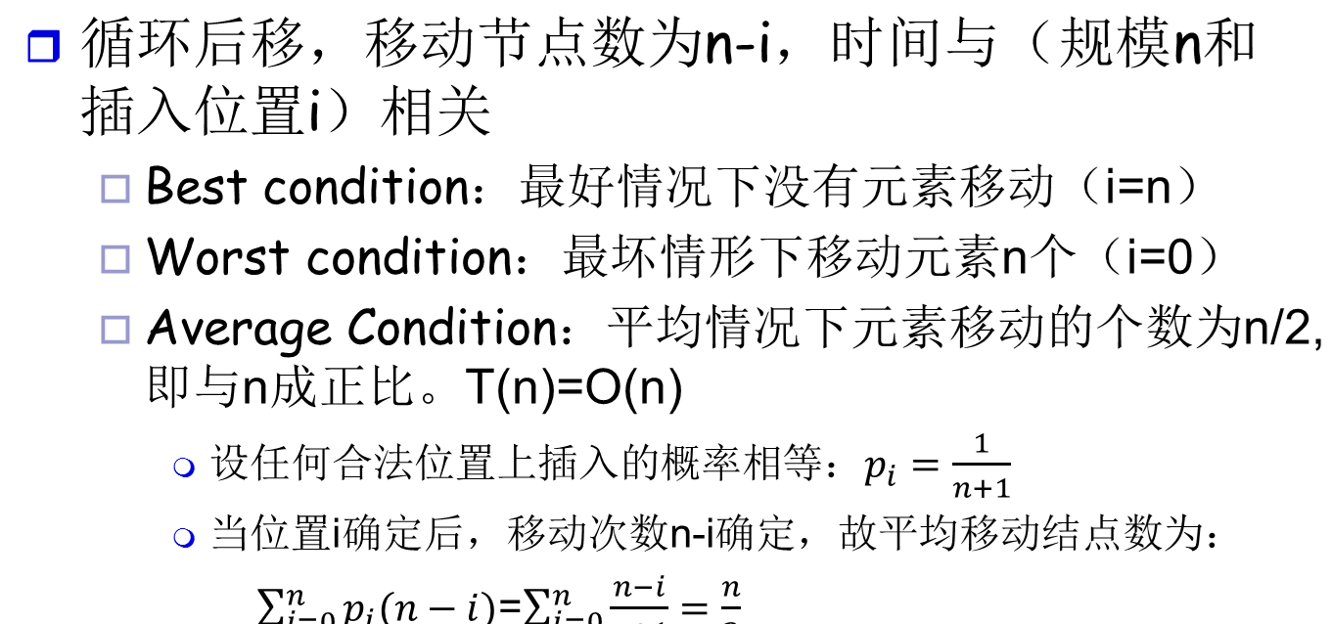
Analysis

Slide 18
Contiguous Implementation
template <class List_entry>
Error_code List<List_entry> :: remove(int position, List_entry &x)
{
if (count == 0) return underflow;
if (position < 0 || position >= count) return range_error;
x = entry[position];
count--;
while (position < count-1) {
entry[position] = entry[position + 1];
position++;
}
return success;
}

Slide 19
L.remove( 4, e)
p
p
p
p
21 18 30 75 42 56 87
0
count-1
21 18 30 75
56
87
while (position < count-1) {
entry[position] = entry[position + 1];
position++;
}

Slide 20
template <class List_entry>
Error_code List<List_entry> :: retrieve(int position, List_entry &x) const
//如果position值非法，返回出错信息，否则根据position的值，取得表中的第position个元素，并由x返回。
{
if (position < 0 || position >= count)
return range_error;
x = entry[position];
return success;
}
在顺序结构中，元素的获取是随机得到的，只要根据数组下标就可以计算出该元素的存储位置，顺序存储结构的特征是随机存取。

Slide 21
Contiguous Implementation
Realization of some member functions
    template <class List_entry>
    void List<List_entry>::traverse(void (*visit)(List_entry&)){
    for (int i=0;i<count;i++)
    (*visit)(entry[i]);
    //此处，visit函数表示指定的遍历时对每个表元素执行的具体动作
    }

Slide 22
void Print_out(List_entry& x)
{cout<<x;
}

Slide 23
In processing a contiguous list with n entries:
  insert and remove require time approximately proportional to n.
   List, clear, empty, full, size, replace, and retrieve operate in constant time.
  the time requirement of traverse is approximately proportional to n.(对每个元素访问一次，基本操作执行次数为n次。)

Slide 24
Advantage
  Simple
  Random access ---适合于读取操作
Disadvantage
  Need move entries when to be inserted or deleted
    Entries are individually small
    the size of the list is small
  Overflow
    max_list

Slide 25

simply Linked Implementation
Declarations
  Node template:
    template <class Node_entry>
    struct Node{
    Node_entry entry;//数据域
    Node<Node_entry> *next;//指针域
    Node();
    Node(Node_entry, Node<Node_entry>* link=NULL);
    //此处提供了两个构造函数，彼此间是函数的重载关系，函数的具体实现与4.1.3中的方法基本一样。
    };
head

Slide 26
simply Linked Implementation
  List template
    template <class List_entry>
    class List{
    public:
    List(const List<List_entry>& copy); //拷贝构造函数
    ~List(); //析构函数
    void operator=(const List<List_entry>& copy);
    //赋值运算符号的重载
    //声明ADT中定义的insert、remove等
    protected:
    int count; //结点数量
    Node <List_entry> *head; //单链表的头指针
    Node <List_entry> * set_position(int position) const;
    //获得第position个结点的位置——返回指针
    };

Slide 27
    List(); //构造函数
    int size() const;
    bool full() const;
    bool empty() const;
    void clear();
    void traverse(void (*visit)(List_entry& ));
    Error_code retrive(int position,List_entry& x) const;
    Error_code replace(int position, const List_entry& x);
    Error_code remove(int position, List_entry& x);
    Error_code insert(int position, const List_entry& x);

Slide 28
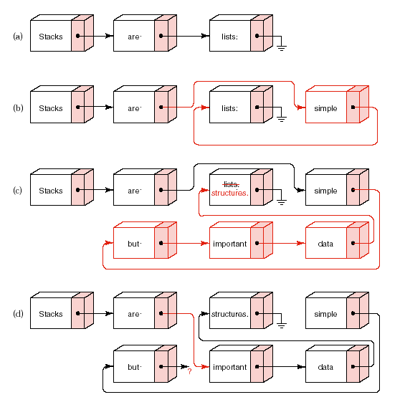
simply Linked Implementation

Slide 29
simply Linked Implementation
Some member functions
  set_position
  template <class List_entry>
  Node<List_entry>* List<List_entry>::set_position(int position) const{
  Node <List_entry> *q=head;
  for (int i=0;i<position;i++)
  q=q->next;
  return q;
  }
  T(n)=O(n)
head

Slide 30
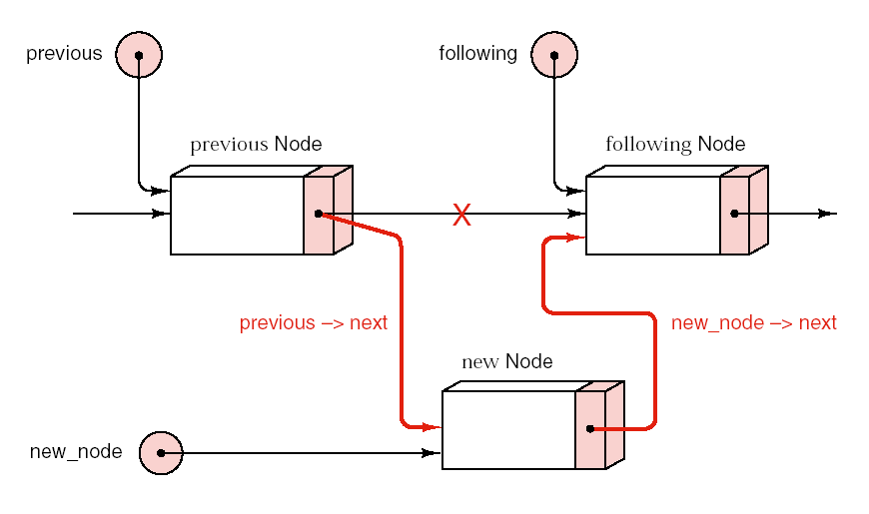
simply Linked Implementation
  insert
    insert process
  new_node=new Node<List_entry>(x,following);
  if (new_node==NULL) return overflow; //判断是否溢出
  previous->next=new_node;

Slide 31
    template <class List_entry>
    Error_code List<List_entry>::insert(int position,const List_entry& x){
    }

Slide 32
    template <class List_entry>
    Error_code List<List_entry>::insert(int position,const List_entry& x){
    if (position<0||position>count) return range_error;
    Node <List_entry> *new_node,*previous,*following;
    if (position>0){
    previous=set_position(position-1);
    //寻找插入点前一个结点位置
    following=previous->next;
    }
    else following=head; //定位插入点的后继位置
    new_node=new Node<List_entry>(x,following);
    //生成一个新结点并插在following之前
    if (new_node==NULL) return overflow;//判断是否溢出
    if (position==0) head=new_node;
    //在0号位置插入时，将head指向新插入结点
    else previous->next=new_node;
    //其他位置插入时，将新结点连接在previous之后
    count++; //计数器变化
    return success;
    }
时间效率分析：
      T(n)=O(n)

Slide 33
    template <class List_entry>
    Error_code List<List_entry>::remove(int position,const List_entry& x){
    }
head

Slide 34
template <class List_entry>
Error_code List<List_entry> :: remove(int position, List_entry &x)
{
Node<List_entry> *prior, *current;
if (count == 0) return fail;
if (position < 0 || position >= count) return range_over;
if (position > 0) {
previous = set_position(position − 1);
current = previous->next;
previous ->next = current->next;
}
else {
current = head;
head = head->next;
}
x = current->entry;
delete current;
count−−;
return success;
}

Slide 35
variation: keeping current position
disadvantage of simply Linked List
  accesses an entry of the list begins by tracing through the list from its start until the desired position is reached.
improvement
  remember the last-used position in the list
attention
  it will not speed up every application using lists.
  mutable data members :used to record the last-used position. (can be changed, even by constant methods)

Slide 36
variation: keeping current position
Enlarged definition
  template <class List_entry>
  class List{
  public:
  //add specifications for the methods of the list ADT
  //all methods in previous definition
  protected:
  int count;
  mutable int current_position;
  Node<List_entry> *head;
  mutable Node<List_entry> *current;
  void set_postion(int position) const;
  };

Slide 37
All the new class members have protected visibility, so, from the perspective of a client, the class looks exactly like the earlier implementation.
The current position is now a member of the class List, so there is no longer a need for set_position to return a pointer; instead, the function simply resets the pointer current directly within the List.

Slide 38
variation: keeping current position
realization of new set_position method
  template <class List_entry>
  void List<List_entry>::set_postion(int position) const{
  if (position<current_position){ //从头开始
  current_position=0;
  current=head;
  }
  //从current开始，进行后移
  for (;current_position!=position; current_position++)
  current=current->next;
  };

Slide 39
    realization of insert function
    template <class List_entry>
      Error_code List<List_entry>::insert(int position,const List_entry& x){
      if (position<0||position>count) return range_error;
      Node <List_entry> *new_node,*previous,*following;
      if (position>0){
      set_position(position-1);
      //寻找插入点前一个结点位置
      following=current->next;
      }else following=head; //定位插入点的后继位置
      new_node=new Node<List_entry>(x,following);
      //生成一个新结点并插在following之前
      if (new_node==NULL) return overflow;//判断是否溢出
      if (position==0) head=new_node;
      //在0号位置插入时，将head指向新插入结点
      else current->next=new_node;
      //其他位置插入时，将新结点连接在previous之后
      count++; //计数变化
      current=current->next;
      current_position++;
      return success;
      }

Slide 40
For repeated references to the same position, neither the body of the if statement nor the body of the for statement will be executed, and hence the function will take almost no time.(重复访问某个结点时)
If we move forward only one position, the body of the for statement will be executed only once, so again the function will be very fast.（向后访问时）
If it is necessary to move backwards through the List, then the function operates in almost the same way as the version of set position used in the previous implementation.（向前访问时）

Slide 41
Supplement :Add a dummy node
    template <class List_entry>
    class List{
    public:
    List(const List<List_entry>& copy); //拷贝构造函数
    ~List(); //析构函数
    void operator=(const List<List_entry>& copy);
    //赋值运算符号的重载
    //声明ADT中定义的insert、remove等
    protected:
    int count; //结点数量
    Node <List_entry> *head; //单链表的头指针
    Node <List_entry> * set_position(int position) const;
    //获得第position个结点的位置——返回指针
    };
head

Slide 42
Supplement :Add a dummy node
  template <class List_entry>
  Node<List_entry>* List<List_entry>::set_position(int position) const
  {
  Node <List_entry> *q=head;
  for (int i=-1;i<position;i++) q=q->next;
  return q;
  }

Slide 43
Supplement :Add a dummy node
      if (position<0||position>count) return range_error;
      Node <List_entry> *new_node,*previous,*following;
      previous=set_position(position-1);
      //寻找插入点前一个结点位置
      following=previous->next;
      new_node=new Node<List_entry>(x,following);
      //生成一个新结点并插在following之前
      if (new_node==NULL) return overflow;//判断是否溢出
      previous->next=new_node;
      //其他位置插入时，将新结点连接在previous之后
      count++; //计数变化
      return success;
      }

Slide 44
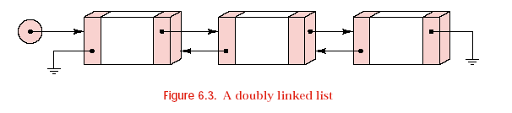
Doubly linked Lists
characteristic of simply linked List
  can access entry in forward order (by the pointer “next”)
  accessing entry in backward order is difficult.
Doubly Linked List

Slide 45
Doubly linked Lists
Doubly Linked List
  Node definition
    template <class Node_entry>
    struct Node{
    Node_entry entry;//数据域
    Node<Node_entry> *next;
    Node<Node_entry> *back; //两个指针域分别指向后继和前驱
    Node();
    Node(Node_entry,Node<Node_entry>* link_back=NULL,
    Node<Node_entry>* link_next=NULL);
    };

Slide 46
Doubly linked Lists
Doubly Linked List
  definition of doubly-linked list class:
    template <class List_entry>
    class List{
    public:
      //Add specification for methods of the list ADT
      //constructors and deconstructor
    protected:
      int count;
      mutable int current_position;
      mutable Node<List_entry>* current;
      void set_position(int position) const;
    //注意：没有了head
    };
    important characteristic:
    current=current->next->back=current->back->next;

Slide 47

Doubly linked Lists
Doubly Linked List
  realization of some member functions
    set_position （设置位置）
      template <class List_entry>
      void List<List_entry>::set_position(int position) const{
      if (current_position<=position)
      for (;current_position!=position;current_position++)
      current=current->next;
      //利用循环进行后移
      else
      for (;current_position!=position;current_position--)
      current=current->back;
      //利用循环进行前移
      }

Slide 48
We can move either direction through the List while keeping only one pointer, current, into the List.(只有current 一个指针）
We do not need pointers to the head or the tail of the List,since they can be found by tracing back or forth from any given node.（不需要头指针或尾指针）
To find any position in the doubly linked list, we first decide whether to move forward or backward from the current position,and then we do a partial traversal of the list until we reach the desired position.（定位之前，先确定是应该往前还是往后，然后再作相应的移动）

Slide 49
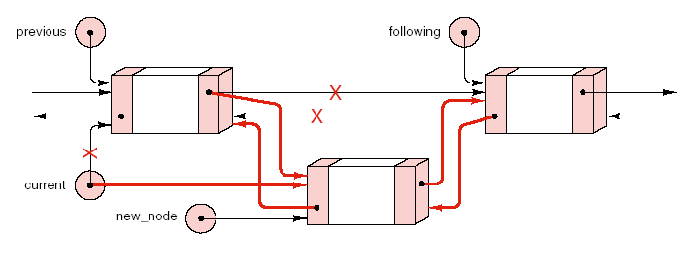
Doubly linked Lists
Doubly Linked List
  realization of some member functions:
    Insert（插入结点）

Slide 50
Doubly linked Lists
template <class List_entry>
  Error_code List<List_entry>::insert(int position, const List_entry& x){
  if (position<0||position>count) return range_error;
  Node<List_entry> *new_node,*following,*preceding;
  //为插入做好准备工作，包括following和preceding
  if (position==0){
  if (count==0) following=NULL;
  else{
  set_position(0);
  following=current;
  }
  preceding=NULL;
  }

Slide 51
Doubly linked Lists
    else{
    set_position(position-1);
    preceding=current;
    following=preceding->next;
    }
    //新增结点，并进行插入
    new_node=new Node<List_entry>(x,preceding,following);
    if (new_node==NULL) return overflow;
    if (preceding!=NULL) preceding->next=new_node;
    if (following!=NULL) following->back=new_node;
    //插入需要修改两个方向上的指针域
    current=new_node;
    current_position=position;
    count++;
    return success;
    }

Slide 52
删除
a_{i-1}
a_{i-1}
a_{i}
a_{i+1}
Old_node

Slide 53
template <class List_entry>
Error_code List<List_entry> :: remove(int position, List_entry &x)
/* Post: If 0<position < n; where n is the number of entries in the List, the function succeeds:
The entry in position is removed from the List, and the entries in all later positions have their position numbers decreased by 1. The parameter x records a copy of the entry formerly in position. Otherwise the function fails with a diagnostic error code. */
{
Node<List_entry> *old_node, *neighbor;
if (count == 0) return fail;
if (position < 0 || position >= count) return range_error;
set_position(position);
old_node = current;

Slide 54
if (neighbor = current->back)
neighbor->next = current->next;
if (neighbor = current->next) {
neighbor->back = current->back;
current = neighbor;
}
else {
current = current->back;
current_position--;
}
x = old_node->entry;
delete old_node;
count--;
return success;
}

Slide 55
A contiguous list:
Overflow,
Must determine the maximum amount of the list,
Insert will cause moving .
Random access
A linked list:
Don’t worry about overflow
Dynamic structure
Insert only need change the links.
The links also take space. (When the node is large,…)
Not to suited to random access.

Slide 56
Comparison of Implementations
Contiguous storage is generally preferable
  when the size of the list is known when the program is written;
  when the entries are individually very small;
  when few insertions or deletions need to be made except at the end of the list;
  when random access is important
Linked storage prove superior
  when the size of the list is not known in advance;
  when the entries are large;
  when flexibility is needed in inserting, deleting and rearranging the entries

Slide 57
To choose among linked list implementations, consider:
Which of the operations will actually be performed on the list and which of these are the most important?(需要哪些操作，那个最重要？）
Is there locality of reference? That is, if one entry is accessed,is it likely that it will next be accessed again?（引用是否有连续性）
Are the entries processed in sequential order? If so, then it may be worthwhile to maintain the last-used position as part of the list structure.（元素是否按顺序访问，如果是，则值得保留一个最近使用的位置。）
Is it necessary to move both directions through the list? If so,then doubly linked lists may prove advantageous.（是否需要向两个方向操作？如果是，则用双向链表比较好。）

Slide 58
1、对不带头结点的单链表，删除其中所有值为x的结点。
请设计非递归和递归算法。
2、删除其中重复的结点。

Slide 59
非递归版本
template <class List_entry>
Error_code List<List_entry> :: removeall( List_entry &x)
{
}

Slide 60
递归版本
template <class List_entry>
Error_code List<List_entry> :: removeall( List_entry &x)
{
head=recursive_removeall(head,x);
return success;
}

Slide 61
template <class List_entry>
Node<List_entry>* List<List_entry> ::
recursive_ removeall (Node<List_entry> *L, List_entry x)
{//在L为首指针的链表中删除所有值为x的结点，
//返回删除后生成的新链表的首结点
if (L==NULL) return NULL;//空表下的删除
Else
{
L->next= recursive_ removeall(L->next,x);
if (L->data==x) //首结点需要删除
{
temp=L;
L=L->next;
delete(temp);
}
}

Slide 62
template <class List_entry>
Error_code List<List_entry> :: reverse()
{
head=recursive_reverse(head);
return success;
}

Slide 63
template <class List_entry>
Node<List_entry>* List<List_entry> ::
recursive_ reverse (Node<List_entry> *head)
{
if (head==NULL) return NULL;
if (head->next==NULL) return head;
p=head->next;head->next=NULL;
new_head=recursive_reverse(p);
p->next=head;
return new_head;
}

Slide 64
对不带头结点的单链表，设计递归算法在指定的位置i上插入x。
template <class List_entry>
  Error_code List<List_entry>::insert(int i, const List_entry x){
  return recursive_insert(head,i,x);
  }

Slide 65
template <class List_entry>
Error_code List<List_entry> :: recursive_ insert (Node<List_entry>* &L, int i,List_entry x){
if ((L==NULL && i>0)|| (i<0))
return range_error;
if (i==0){
Node<List_entry>* newNode=new Node<List_entry>(x,L);
L= newNode;}
else{
L->next=recursive_insert(L->next, x,i-1);
}
return success;
}

Slide 66
补充习题：
1.Reverse the order of all entries in a contiguous List and in a simple linked list as a list method.
template <class List_entry>
Error_code List<List_entry> :: reverse()

Slide 67
2.join two ordered list in a List,.
Error_code Join(List a_list,List b_list,List &c_list)
example :
a_list=(1,3,5,7,9)
b_list=(2,4,7,10,13)
After the joint,c_list=(1,2,3,4,5.7,7,9,10,13)
Not depend on the implementation!

Slide 68
Linked Lists in Arrays
For several of the older but widely-used computer languages, do not provide facilities for dynamic storage allocation or pointers.
the implementation of linked lists within arrays proves valuable.
  The number of entries in a list is known in advances
  The links are frequently rearranged, but relatively few additions or deletions are made
  The same data are sometimes best treated as a linked list and other times as a contiguous list

Slide 69
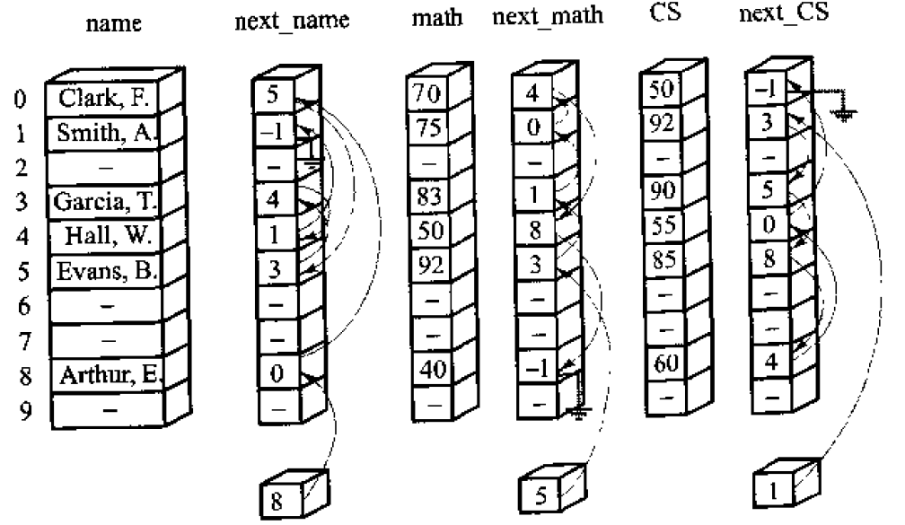
Example of linked lists in arrays

Slide 70
Operations: space management
the dynamic allocation of storage is invariably lost in this implementation, all the remaining advantages will be kept.
set up a list of available space and write auxiliary functions to obtain a new node and to return a node to available space.

Slide 71
Operations: space management
Available workspace comprises two parts:
  There are nodes that have never been allocated
    ---last_used: indicates the position of the last node that has been used at some time.
  There are nodes that have previously been used but have now been released
    ---available: top of the stack to keep track of the nodes that have been previously used and then returned to available space.
  (when allocate a new node from available space, check the stack. If this stack is empty, use the space having never been allocated)

Slide 72
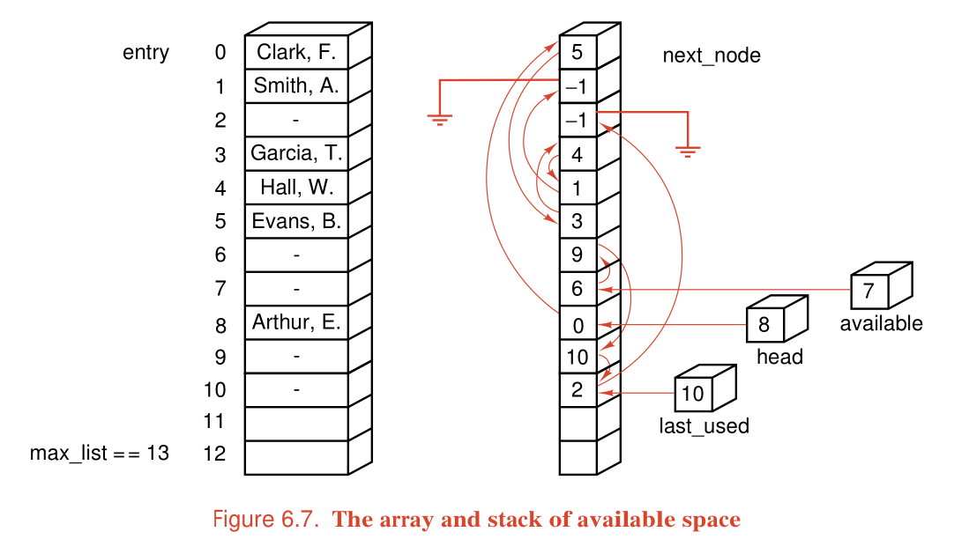
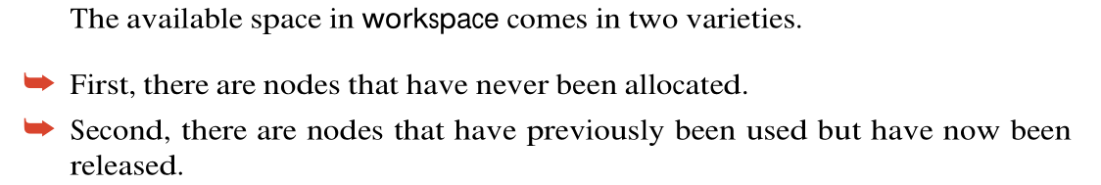
Operations: space management

Slide 73
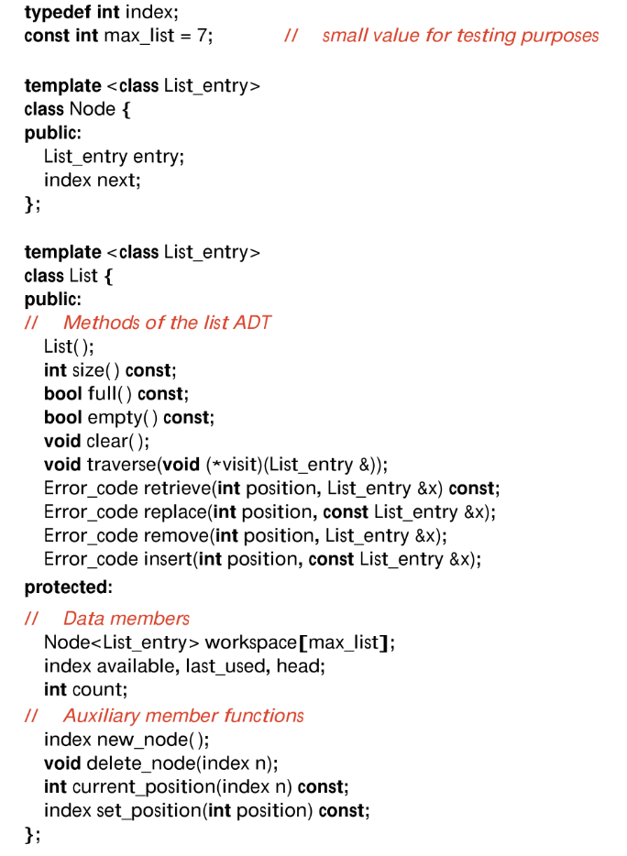
Specification：

Slide 74
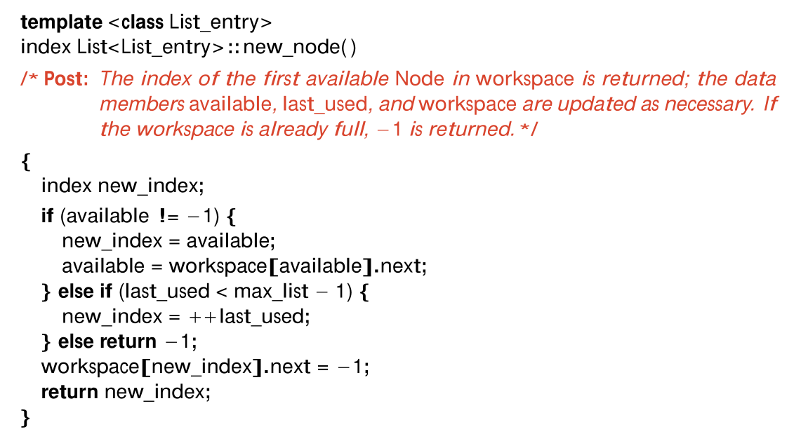
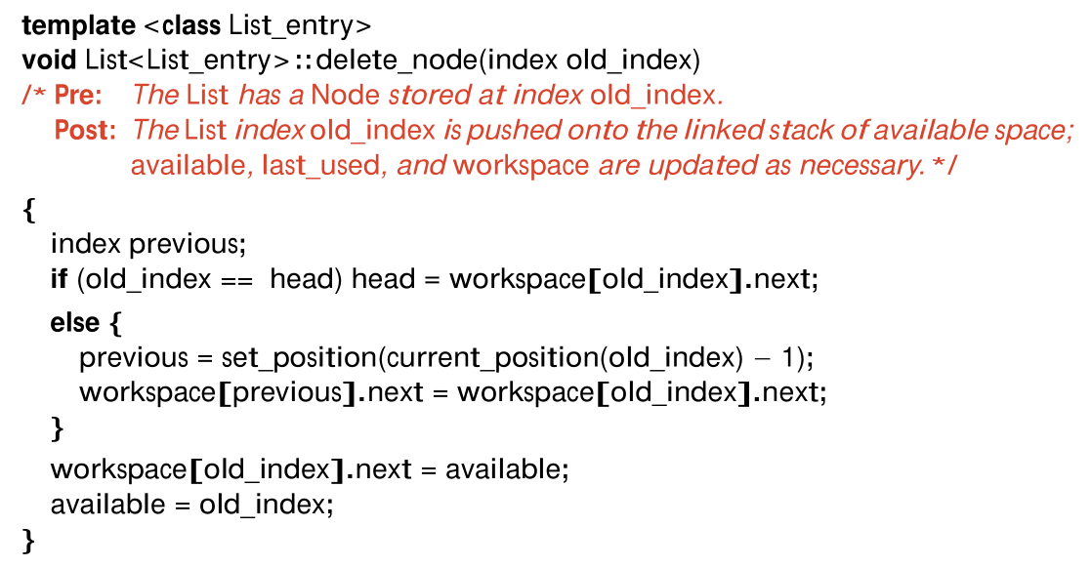

Slide 75
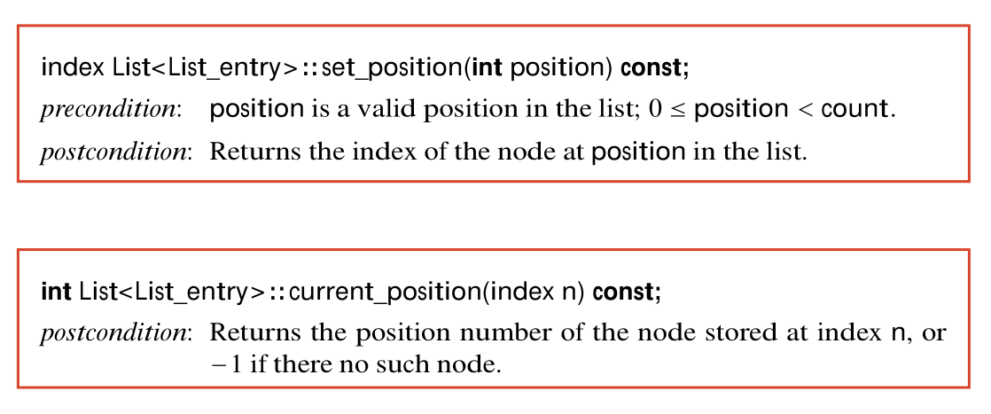
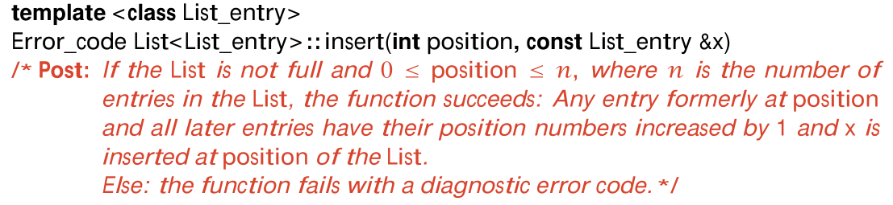
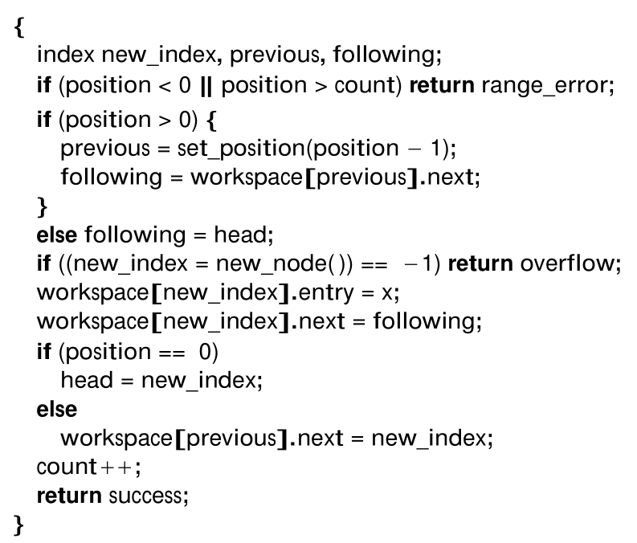

Slide 76
Strings
Strings in C——not encapsulated
Every C-string has type char *. Hence, a C-string references an address in memory, the first of a contiguous set of bytes that store the characters making up the string.
The storage occupied by the string must terminate with the special character value ‘\0’.
The standard header file <cstring> (or <string.h>) contains a library of functions that manipulate C-strings.
some important functions:
  char* strcpy(char* to, char* from);
  int strcmp(char* one, char* two);
  char* strcat(char* to, char* from);
  int strlen(char* str);

Slide 77
Strings
Strings in C++——encapsulated
In C++, the output operator << is overloaded to apply to cstrings, so that a simple instruction cout << s prints the string s.
In C++, it is easy to use encapsulation to embed C-strings into safer class-based implementations of strings.
The standard template library includes a safe string implementation in the header file <string>. This library implements a class called std :: string that is convenient, safe, and efficient.
    #include <string>
    using namespace std;

Slide 78
Strings implementation
  class specification:
    class String{
    public:
    (1)String(); //构造函数
    (2)~String(); //析构函数
    (3)String(const String &copy); //拷贝构造函数
    (4)String(const char* copy); //将C字符串转成C++中的串
    (5)String(List<char> &copy); //将List转成C++串
    (6)void operator=(const String &copy); //赋值符号重载
    (7)const char* c_str() const; //转成C中的字符串，为什么需要这个方法？
    protected:
    char* entries;
    int length;
    };
1 4 6
String s;
S=“some_string”;
4
4 7
String s=“some_string”;
const char *new_s=s.c_str();
String s(“some_string”);

Slide 79
Strings
Strings in C++
  全局重载操作符
    bool operator==(const String& first, const String& second);
    bool operator>(const String& first, const String& second);
    bool operator<(const String& first, const String& second);
    bool operator>=(const String& first, const String& second);
    bool operator<=(const String& first, const String& second);
    bool operator!=(const String& first, const String& second);
运算符 | 规则
所有的一元运算符 | 建议重载为成员函数
= () [] -> | 只能重载为成员函数
+= -= /= *= &= |= ~= %= >>= <<= | 建议重载为成员函数
所有其它运算符 | 建议重载为全局函数

Slide 80
Strings
realization of some important methods
    //利用C的字符串构造
    String::String(const char* in_string){
    length=strlen(in_string);
    entries=new char[length+1];
    strcpy(entries,in_string);
    }
    //利用List进行构造
    String::String(List<char>& in_list){
    length=in_list.size();
    entries=new char[length+1];
    for (int i=0;i<length;i++)
    in_list.retrieve(i,entries[i]);
    entries[length]=‘\0’;
    }

Slide 81
Strings
realization of some important methods
  //转成C中的字符串
  const char* String::c_str() const
  {
  return (const char*) entries;//提供到内部String数据的访问
  }
  //有什么问题？是否有更好的办法？
String s=“abc”;
const char *new_string=s.c_str();
s=“def”;//调用赋值重载，要将s的原空间回收！
cout<<new_string;

Slide 82
可选的实现：
为string数据的副本分配动态内存。
  const char* String::c_str() const
  {int len;
  char * temp;
  len=strlen(entries;)
  temp=new char[len+1];
  strcpy(temp,entries);
  return temp;
  }
String s=“some very_long string”;
cout<<s.c_str();
//效率低，特别是字符串很长时
//客户程序必须记住使用之后要删除它，否则会因为临时对象没有删除而产生了垃圾！

Slide 83
Strings
    //等于等于符号的重载
    bool operator= =(const String& first, const String& second)
    {
    return (strcmp(first.c_str(),second.c_str())==0);
    }

Slide 84
Further String Operations
void strcat(String &add_to, const String &add_on)
void strcpy(String &copy, const String &original);
void strncpy(String &copy, const String &original, int n);
int strstr(const String &text, const String &target);
String read_in(istream &input)
String read_in(istream &input, int terminator);
void write(String &s)

Slide 85
Samples of Further String Operations
void strcat(String &add_to, const String &add_on)
/* Post: The function concatenates String add on onto the end of String add to .*/
{
const char *cfirst = add_to.c_str( );
const char *csecond = add_on.c_str( );
char *copy = new char[strlen(cfirst) + strlen(csecond) +1];
strcpy(copy, cfirst);
strcat(copy, csecond);
add_to = copy;
delete []copy;
}

Slide 86
int strstr(const String &text, const String &target);
/*postcondition: If String target is a substring of String text, the function returns the array index of the first occurrence of the string stored in target in the string stored in text.
else: The function returns a code of -1.*/
{
int answer;
const char * content_s = text.c_str( );
char *p = strstr((char *) content_s, targer.c_str( ));
if (p == NULL)
answer = -1;
else
answer = p- content_s;
return answer;
}

Slide 87
String read_in(istream &input)
/* Post: Return a String read (as characters terminated by a newline or an end-of-file character) from an istream parameter. */
{
List<char> temp;
int size = 0;
char c;
while ((c = input.peek( )) != EOF && (c = input.get( )) != ‘\n’)
  temp.insert(size++, c);
String answer(temp);
return answer;
}

Slide 88
We shall also find it useful to apply the following String output function as an alternative to the operator << .
void write(String &s)
/* Post: The String parameter s is written to cout. */
{
cout << s.c_str( ) << endl;
}

